Slide 1
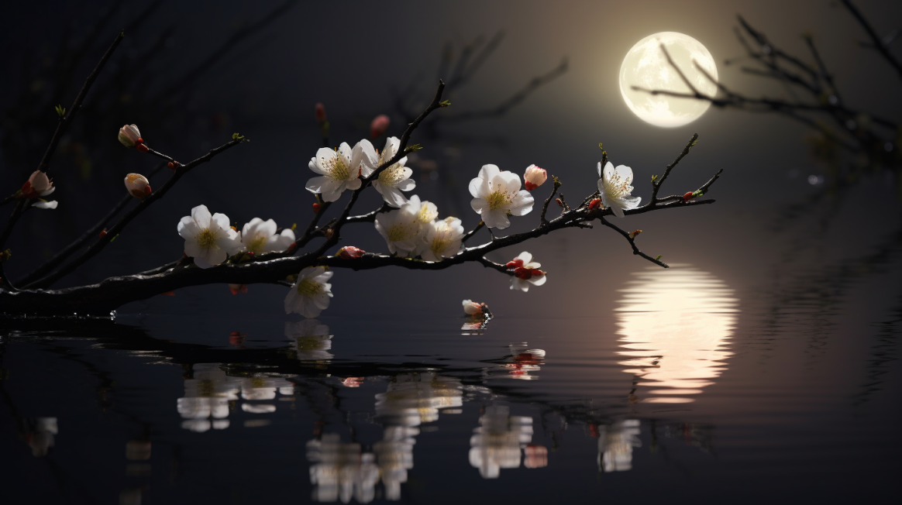
疏影横斜水清浅，暗香浮动月黄昏。
GPT-4: Slender shadows slanting over shallow waters, a faint fragrance wafts through the dusk of the moonlit night.
Midjourney: The reflection of a full moon in the water, the shadows of few sparse plum flower buds slanting over the shallow water. Realistic landscapes, photographic quality, beautiful scenery, beautiful landscape, ultra-detailed, night lighting, full HD, far view, depth of field --ar 16:9

Slide 2
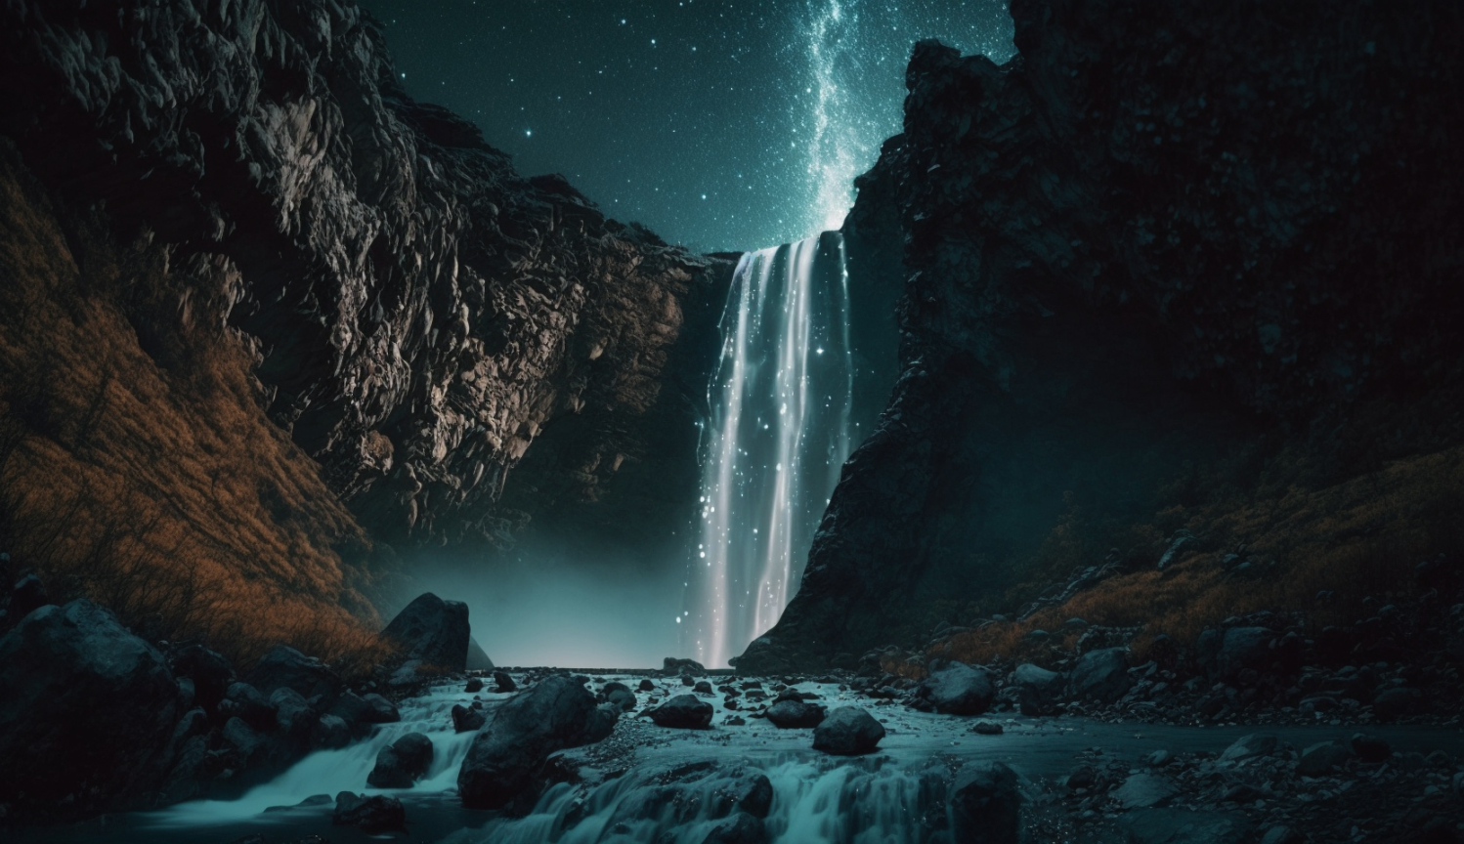
飞流直下三千尺，疑是银河落九天。
GPT-4: A waterfall cascades down three thousand feet, as if the Milky Way has fallen from the ninth heaven.
Midjourney: A waterfall cascades down three thousand feet, as if the Milky Way has fallen from the ninth heaven. Beautiful scenery, extreme detail, hyperrealistic, soft cinematic lighting, real photography fujifilm superia, full HD, wide view, long exposure --ar 16:9

Slide 3
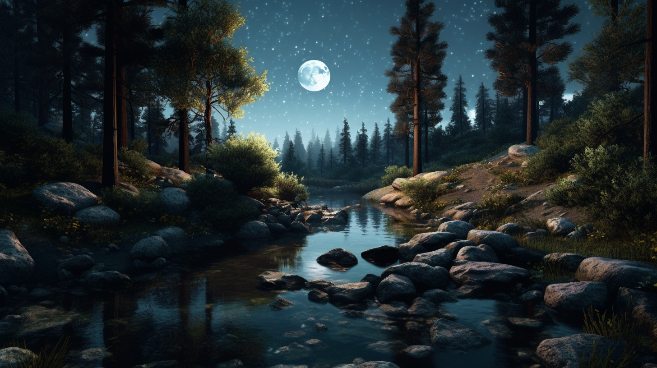
明月松间照，清泉石上流。
GPT-4: The bright moon shines through the pines, the clear spring flows over the stones.
Midjourney: The bright moon shines through the pines, the clear spring flows over the stones. Realistic landscapes, photographic quality, beautiful scenery, beautiful landscape, ultra-detailed, night lighting, full HD, far view, depth of field --ar 16:9

Slide 4
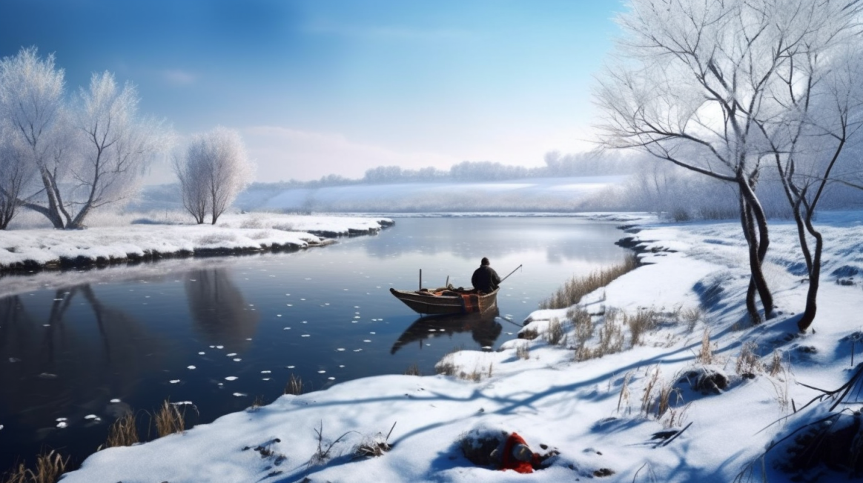
孤舟蓑笠翁，独钓寒江雪。
GPT-4: A solitary boat, an old man in a straw cape and hat, fishing alone in the snowy, cold river.
Midjourney: Winter, a snowy cold river, a solitary boat in a far distance, sitting an old Chinese man in a straw hat, a fishing pole. Realistic landscapes, photographic quality, beautiful scenery, beautiful landscape, ultra-detailed, day light, full HD, far view, depth of field --ar 16:9

Slide 5
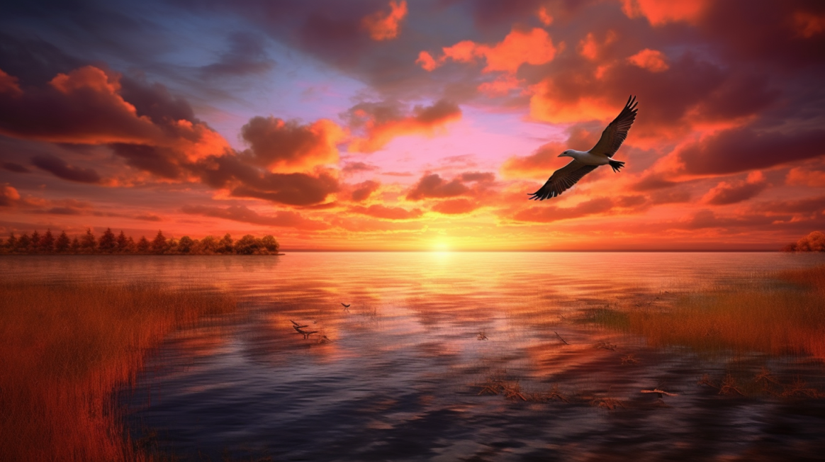
落霞与孤鹜齐飞 秋水共长天一色。
GPT-4: The setting sun and a solitary wild duck fly together, while the autumn waters blend seamlessly with the vast sky.
Midjourney: Autumn, the vast sea blend seamlessly with the vast sky. In a very far distance, a longly flying wild goose in red clouds. Sunset. no trees, no coastlines. Realistic landscapes, photographic quality, beautiful scenery, beautiful landscape, ultra-detailed, strong contrast lighting, full HD, far view, depth of field --ar 16:9

Slide 6
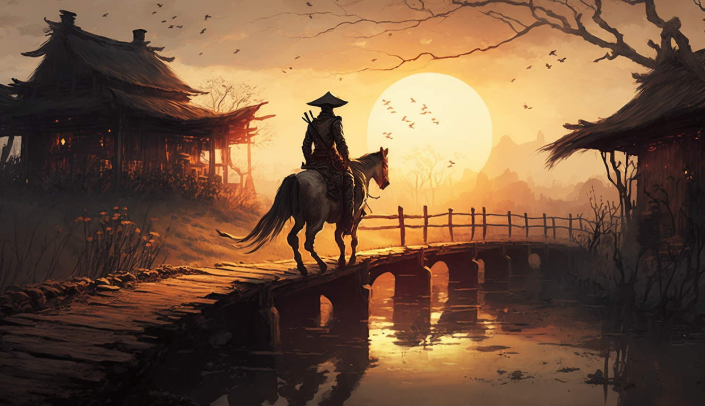
枯藤老树昏鸦，小桥流水人家，古道西风瘦马。夕阳西下，断肠人在天涯。
GPT-4: Withered vines, old trees, cawing crows, a small bridge, flowing water, village homes, an ancient road, a lean horse. The setting sun sinks in the west. A heartbroken human stands at the edge of the world.
Midjourney: The setting sun sinks in the west, a man sitting on a skinny horse with a bamboo hat and a sword on an ancient road, In a long distance, there is a small bridge, flowing water, withered vines, old trees, black crows, village houses. Photorealism, photographic quality, Chinese style, beautiful scenery, beautiful landscape, extreme details, beautiful light, full HD, bird eye view, long exposure, depth of field --ar 16:9

Slide 7
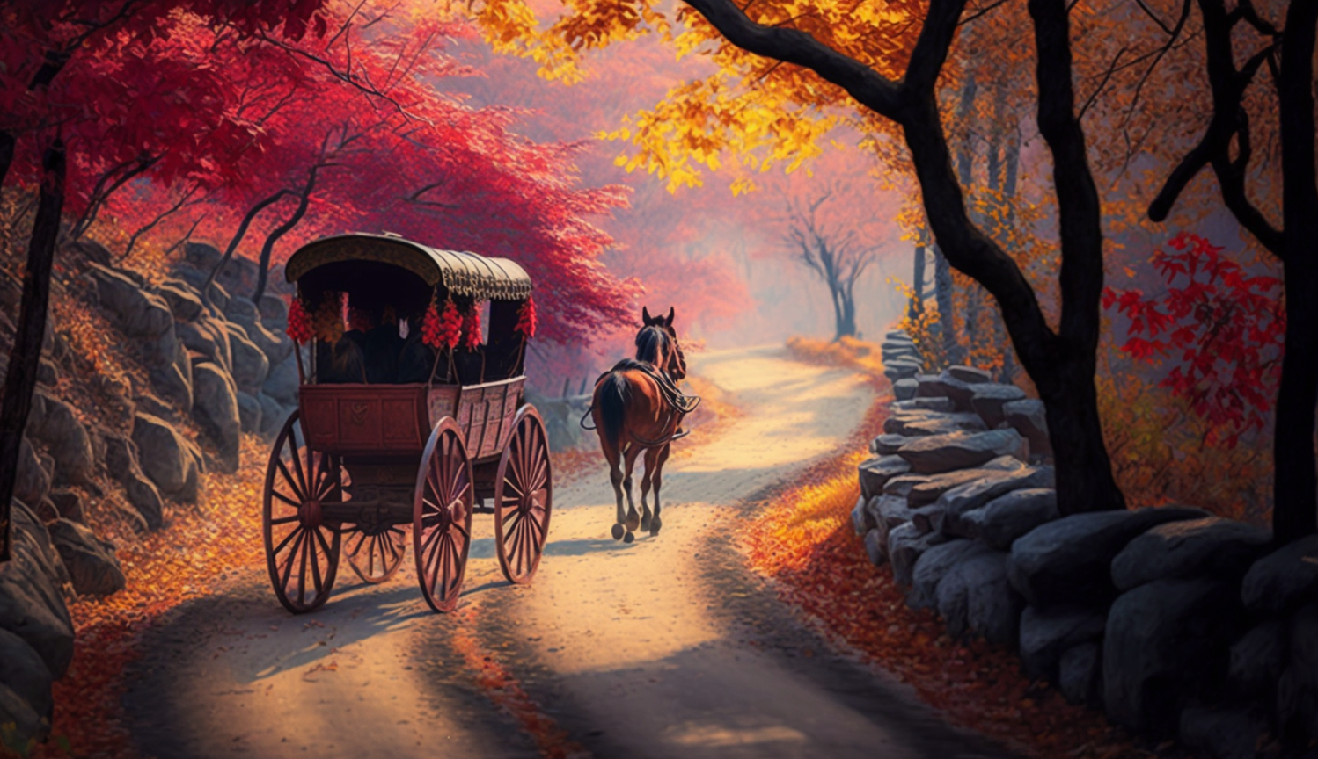
停车坐爱枫林晚，霜叶红于二月花。
GPT-4: Stopping the carriage to admire the maple woods at dusk, frost-touched leaves are redder than the flowers of February.
Midjourney: Autumn, a stone-paved sloping path up the mountain, a Chinese stype horse drawn carriage is stopping at a big red maple forest. Photorealism, photographic quality, Chinese style, beautiful scenery, beautiful landscape, extreme details, beautiful light, full HD, bird eye view, long exposure, depth of field --ar 16:9

